Slide 1
RISC-V Instruction Formats, Part II

Slide 2
Disassembling the S-Format
(Last lecture’s Slide 33)
What is the corresponding assembly instruction?
Store opcode
31 |  |  |  | 25 | 24 |  | 20 | 19 |  | 15 | 14 | 12 | 11 |  | 7 | 6 |  |  |  | 0
imm[11:5] |  |  |  |  | rs2 |  |  | rs1 |  |  | funct3 |  | imm[4:0] |  |  | opcode
0000001 |  |  |  |  | 01110 |  |  | 00010 |  |  | 010 |  | 00100 |  |  | 0100011
S-Format Lookup table:
funct3
 |  |  |  |  | opcode
imm[11:5] | rs2 | rs1 | 000 | imm[4:0] | 0100011 | sb
imm[11:5] | rs2 | rs1 | 001 | imm[4:0] | 0100011 | sh
imm[11:5] | rs2 | rs1 | 010 | imm[4:0] | 0100011 | sw

Slide 3
Disassembling the S-Format
(Last lecture’s Slide 33)
What is the corresponding assembly instruction?
“store word”
Store opcode
31 |  |  |  | 25 | 24 |  | 20 | 19 |  | 15 | 14 | 12 | 11 |  | 7 | 6 |  |  |  | 0
imm[11:5] |  |  |  |  | rs2 |  |  | rs1 |  |  | funct3 |  | imm[4:0] |  |  | opcode
0000001 |  |  |  |  | 01110 |  |  | 00010 |  |  | 010 |  | 00100 |  |  | 0100011
rs2 (“source”)
14
rs1 (“base”)
2
imm (“offset”)
0000001 | 00100
The two “read” reg. fields for S-type and R-type are at the same bit positions.
+36_{ten}
sw rs2, imm(rs1)
sw x14, 36(x2)

Slide 4


Slide 5
Updating the Program Counter (PC)
Updating the Program Counter (PC)
B-Format Layout
J-Format Layout
U-Format: Long Immediates
jalr: I-Format

Slide 6
The Program Counter (PC)
The Program Counter (PC) is a special internal register inside processor holding byte address of the instruction being executed.
It is separate from the 32-registers Register File!
Processor-Memory Interface
I/O-Memory Interfaces
Notes:
Apple M1 Chip is 3.1 GHz max clock rate
7/10 nm transistor density

Slide 7
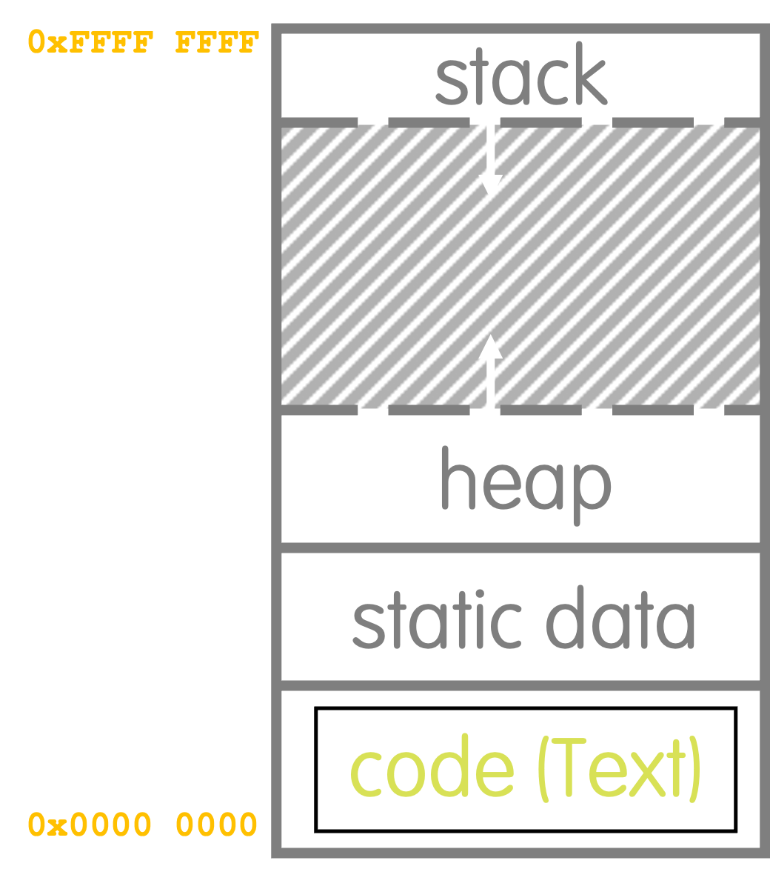
PC = PC + 4 for most instructions
Registers before execution
Address | Machine Code | Original Assembly Code
0x0c | 00A98863 | Loop: | beq x19,x10,End
0x10 | 00A90933 |  | add x18,x18,x10
0x14 | FFF98993 |  | addi x19,x19,-1
0x18 | FF5FF06F |  | j Loop
0x1c | 00A98863 | End: | …
PC
0000 0010
RegFile
x10
x18
x19
0000 0001
0000 0000
0000 0002
Program Address Space
+4
Address | Machine Code | Original Assembly Code
0x0c | 00A98863 | Loop: | beq x19,x10,End
0x10 | 00A90933 |  | add x18,x18,x10
0x14 | FFF98993 |  | addi x19,x19,-1
0x18 | FF5FF06F |  | j Loop
0x1c | 00A98863 | End: | …
PC
0000 0014
RegFile
x10
x18
x19
0000 0001
0000 0001
0000 0002

Slide 8

Branches Update PC to ”Jump”
Unconditional Branches
Conditional Branch (if branch taken)
0x0c | Loop: | beq x19,x10,End
0x10 |  | add x18 x18,x10
0x14 |  | addi x19,x19,-1
0x18 |  | j Loop
0x1c | End: | …
0x0c | Loop: | beq x19,x10,End
0x10 |  | add x18,x18,x10
0x14 |  | addi x19,x19,-1
0x18 |  | j Loop
0x1c | End: | …
PC
PC
0000 0018
0000 000c
RegFile
x10
x18
x19
RegFile
x10
x18
x19
0000 0001
0000 0001
0000 0001
0000 0001
0000 0001
0000 0001
-12
+16
0x0c | Loop: | beq x19,x10,End
0x10 |  | add x18,x18,x10
0x14 |  | addi x19,x19,-1
0x18 |  | j Loop
0x1c | End: | …
0x0c | Loop: | beq x19,x10,End
0x10 |  | add x18,x18,x10
0x14 |  | addi x19,x19,-1
0x18 |  | j Loop
0x1c | End: | …
PC
PC
0000 000c
0000 001c
RegFile
x10
x18
x19
RegFile
x10
x18
x19
0000 0001
0000 0001
0000 0001
0000 0001
0000 0001
0000 0001
If branch not taken, then PC = PC + 4

Slide 9
PC-Relative Addressing
PC-Relative Addressing: Supply a signed offset to update PC.
PC = PC + byte_offset
“Position-Independent Code”: If all of code moves, relative offsets don’t change!
Branches generally change the PC by a small amount, therefore in RISC-V instructions we encode relative offsets as signed immediates.
Contrast with: Absolute Addressing
Supply new address to overwrite PC. PC = new_address
Use sparingly: Brittle to code movement/need to build 32-bit immediate (more later)
0x0c | Loop: | beq x19,x10,End
0x10 |  | add x18, x18,x10
0x14 |  | addi x19, x19,-1
0x18 |  | j Loop
0x1c | End: | …
0x400 | Loop: | beq x19,x10,End
0x404 |  | add x18, x18,x10
0x408 |  | addi x19, x19,-1
0x40c |  | j Loop
0x410 | End: | …
Take branch: PC = PC + 16
Don’t take branch: PC = PC + 4

Slide 10
B-Format Layout
Updating the Program Counter (PC)
B-Format Layout
J-Format Layout
U-Format: Long Immediates
jalr: I-Format

Slide 11
RISC-V Conditional Branches
Example: beq rs1,rs2,Label
Conditional branches need:
Two read registers, no destination register (like S-Format)
Some way to encode label (i.e., where to jump to)
RISC-V uses PC-relative addressing to encode labels.
If we don’t branch: PC = PC + 4 bytes
If we do branch: PC = PC + (relative byte offset to Label)
B-Format Fields:
7b (opcode) + 3b (funct3) + 5b (rs1) + 5b (rs2) = 20b
12b immediate field to represent PC’s relative offset.
Signed two’s complement means we can represent ± 2¹¹ “units” from the PC.

Slide 12

Scaling the Offset to Maximize Branch Range
The 12-bit immediate field for conditional branches is:
In units of 1 byte.
One branch reaches ± 2¹¹ bytes from PC → ± 2⁹ x 32-bit instructions.
Never branch into middle of instruction.
In units of 2 bytes (16-bit “half-words”).
One branch reaches ± 2¹⁰ x 32-b instructions from PC.
Multiply the offset by 2 before adding to the PC.
In units of 4 bytes (32-bit words).
One branch reaches ± 2¹¹ x 32-b instructions from PC.
Multiply the offset by 4 before adding to the PC.
pollev.com/yanl

Slide 13
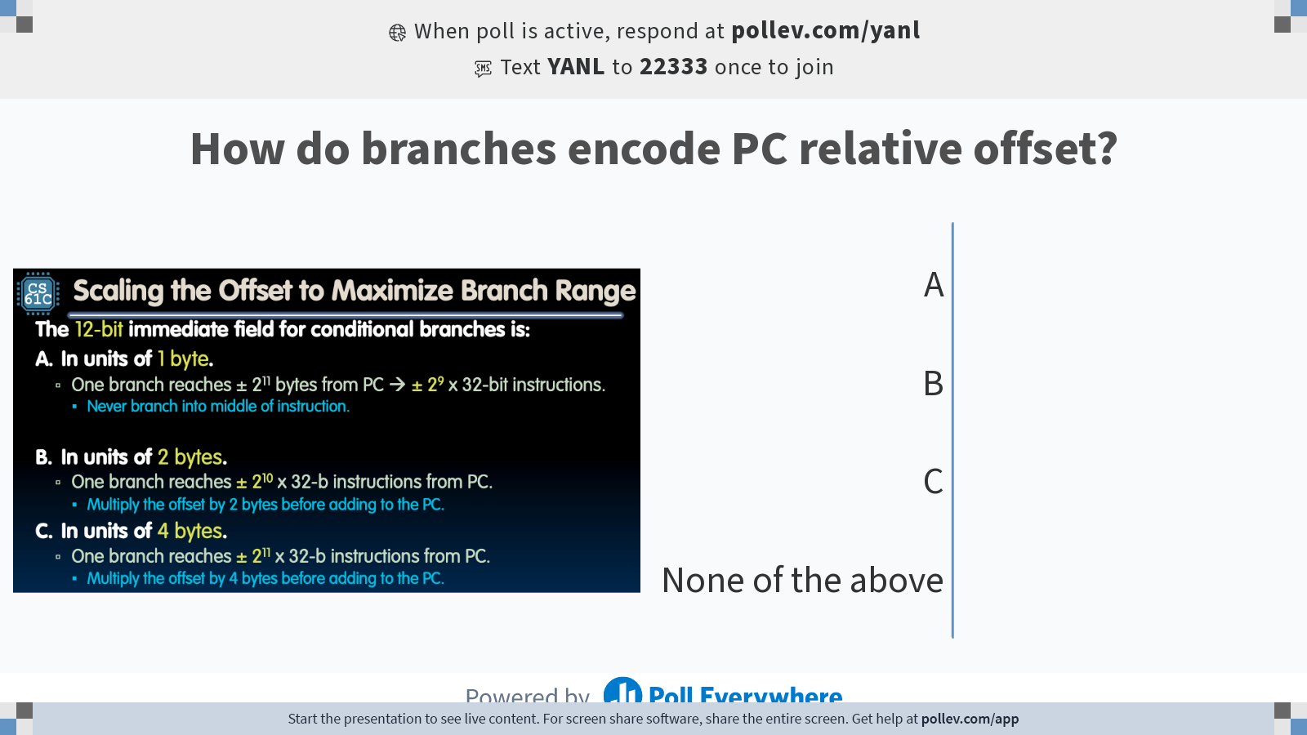
Notes:
Do not modify the notes in this section to avoid tampering with the Poll Everywhere activity. More info at polleverywhere.com/support How do branches encode PC relative offset?
https://www.polleverywhere.com/multiple_choice_polls/fLE1xv4SSVJkYAe9hnWqB?state=opened&flow=Default&onscreen=persist

Slide 14
Scaling the Offset to Maximize Branch Range
The 12-bit immediate field for conditional branches is:
In units of 1 byte.
One branch reaches ± 2¹¹ bytes from PC → ± 2⁹ x 32-bit instructions.
Never branch into middle of instruction.
Wasteful! Lower 2 bits would always be wasted (always 00).
In units of 2 bytes (16-bit “half-words”).
One branch reaches ± 2¹⁰ x 32-b instructions from PC.
Multiply the offset by 2 before adding to the PC.
In units of 4 bytes (32-bit words).
One branch reaches ± 2¹¹ x 32-b instructions from PC.
Multiply the offset by 4 before adding to the PC.
Does not support 16-bit compressed instructions!
❌
✅
Branch immediate range [-2048, +2047] represents PC relative offsets [-4096, +4094] in 2-byte increments.
❌

Slide 15
RISC-V Feature: 16-bit instructions
RISC-V Base ISA for RV32, RV64, RV128 all have 32-bit wide instructions, but it supports extensions:
16b compressed instructions
Variable-length instructions that are multiples of 16b in length
RISC-V therefore scales the branch offset by 2 bytes, even when there are no 16b instructions!
Implications for this class (which uses RISC-V processors that only support 32-bit instructions):
Half of the possible branch targets will be errors.
RISC-V Conditional Branches can only reach ±2¹⁰ 32-bit instructions on either side of PC.

Slide 16
B-Format Instruction Layout
B-Format (textbook: SB-Type) close to S-Format:
All conditional branch instructions have opcode 1100011.
opname rs1,rs2,Label
31 |  |  |  | 25 | 24 |  | 20 | 19 |  | 15 | 14 | 12 | 11 |  | 7 | 6 |  |  |  | 0
imm[12|10:5] |  |  |  |  | rs2 |  |  | rs1 |  |  | funct3 |  | imm[4:1|11] |  |  | opcode
7 |  |  |  |  | 5 |  |  | 5 |  |  | 3 |  | 5 |  |  | 7
Immediate represents relative offset in increments of 2 bytes (“half-words”)
To compute new PC: PC = PC + byte_offset.
12 immediate bits imply ±2¹⁰ 32-bit instructions reachable:
1 bit: 2’s complement (allow +/– offset)
1 bit: half-word/16-b instruction support
(Lowest bit of offset is always zero, so no need to store in instruction.)
31 |  |  |  | 25
imm[12|10:5]
zxxxxxx
11 |  |  |  | 7
imm[4:1|11]
wwwwy
12 | 11 | 10 | 9 | 8 | 7 | 6 | 5 | 4 | 3 | 2 | 1 | 0
z | y | x | x | x | x | x | x | w | w | w | w | 0
byte_offset (“imm“)

Slide 17
B-Format Example (1/2)
Loop: | beq x19,x10,End
 | add x18,x18,x10
 | addi x19,x19,-1
 | j Loop
End: | … # target instr
How do we encode the beq instruction in this RISC-V code?
Fill in fields (other than immediate).
BRANCH opcode
“beq”
31 |  |  |  | 25 | 24 |  | 20 | 19 |  | 15 | 14 | 12 | 11 |  | 7 | 6 |  |  |  | 0
imm[12|10:5] |  |  |  |  | rs2 |  |  | rs1 |  |  | funct3 |  | imm[4:1|11] |  |  | opcode
 |  |  |  |  | 01010 |  |  | 10011 |  |  | 000 |  |  |  |  | 1100011
rs2
10
rs1
19

Slide 18
B-Format Example (2/2)
Loop: | beq x19,x10,End
 | add x18,x18,x10
 | addi x19,x19,-1
 | j Loop
End: | … # target instr
How do we encode the beq instruction in this RISC-V code?
+4 instruct-ions
Construct branch offset (in bytes), then encode immediate.
31 |  |  |  | 25 | 24 |  | 20 | 19 |  | 15 | 14 | 12 | 11 |  | 7 | 6 |  |  |  | 0
imm[12|10:5] |  |  |  |  | rs2 |  |  | rs1 |  |  | funct3 |  | imm[4:1|11] |  |  | opcode
 |  |  |  |  | 01010 |  |  | 10011 |  |  | 000 |  |  |  |  | 1100011
0000000
10000
+4 32-bit instructions = +16 byte offset
12 | 11 | 10 | 9 | 8 | 7 | 6 | 5 | 4 | 3 | 2 | 1 | 0
0 | 0 | 0 | 0 | 0 | 0 | 0 | 0 | 1 | 0 | 0 | 0 | 0
13-bit signed byte_offset (“imm“)
Notes:
Be careful…

Slide 19
Why Swirl Immediate Bits Around? HW Design!
Recall: RISC-V register field positions consistent across instr. formats.
RISC-V also tries to keep bit positions of immediates consistent:
31 |  |  |  | 25 | 24 |  | 20 | 19 |  | 15 | 14 | 12 | 11 |  | 7 | 6 |  |  |  | 0
imm[11:5] |  |  |  |  | imm[4:0] |  |  | rs1 |  |  | funct3 |  | rd |  |  | opcode
imm[11:5] |  |  |  |  | rs2 |  |  | rs1 |  |  | funct3 |  | imm[4:0] |  |  | opcode
imm[12|10:5] |  |  |  |  | rs2 |  |  | rs1 |  |  | funct3 |  | imm[4:1|11] |  |  | opcode
31 |  |  |  | 25 | 24 |  | 20 | 19 |  | 15 | 14 | 12 | 11 |  | 7 | 6 |  |  |  | 0
imm[11:5] |  |  |  |  | imm[4:0] |  |  | rs1 |  |  | funct3 |  | rd |  |  | opcode
yxxxxxx |  |  |  |  | wwwwv
imm[11:5] |  |  |  |  | rs2 |  |  | rs1 |  |  | funct3 |  | imm[4:0] |  |  | opcode
yxxxxxx |  |  |  |  |  |  |  |  |  |  |  |  | wwwwv
imm[12|10:5] |  |  |  |  | rs2 |  |  | rs1 |  |  | funct3 |  | imm[4:1|11] |  |  | opcode
zxxxxxx |  |  |  |  |  |  |  |  |  |  |  |  | wwwwy
I-type
S-type
B-type
Instruction Bit 31 is always the sign bit (highest bit to sign extend in immediate)
B-type has a 13-bit immediate encoding b/c of implicit zero in Imm bit 0.
Between S and B, only two bits change meaning:
Instruction Bit 7 → S: Imm Bit 0; B: Imm Bit 11
Instruction Bit 31→ S: Imm Bit 11; B: Imm Bit 12
RISC-V immediate bit encoding is optimized to reduce hardware cost.

Slide 20
All six RV32 B-Format Instructions
 |  |  | funct3 |  | opcode
imm[12|10:5] | rs2 | rs1 | 000 | imm[4:1|11] | 1100011 | beq
imm[12|10:5] | rs2 | rs1 | 001 | imm[4:1|11] | 1100011 | bne
imm[12|10:5] | rs2 | rs1 | 100 | imm[4:1|11] | 1100011 | blt
imm[12|10:5] | rs2 | rs1 | 101 | imm[4:1|11] | 1100011 | bge
imm[12|10:5] | rs2 | rs1 | 110 | imm[4:1|11] | 1100011 | bltu
imm[12|10:5] | rs2 | rs1 | 111 | imm[4:1|11] | 1100011 | bgeu

Slide 21
Conditionally Branching Even Further
Conditional Branches are typically used for if-else statements, for/while loops.
Usually pretty small (<50 lines of C code)
B-Format has limited range:
± 2¹⁰ 32-bit instructions from current instruction
What if destination is further away?
Enter the unconditional jump!
beq x10, x0, far
# next instr
if not equal
bne x10, x0, next
j far
next: # next instr
functionally equivalent
if equal
if equal

Slide 22
J-Format Layout
Updating the Program Counter (PC)
B-Format Layout
J-Format Layout
U-Format: Long Immediates
jalr: I-Format

Slide 23
The jal instruction and j pseudoinstruction
Review
jal does a Jump And Link (i.e., “link and jump”):
jal rd, Label
Jump to Label
Write address of the following instruction to rd.
Two use cases:
Call a function (and simultaneously save return address in named register)
Unconditional branch
j pseudoinstruction: jump and discard return address
jal ra, FuncLabel
j Label
jal x0, Label

Slide 24
The jal instruction and j pseudoinstruction
jal does a Jump And Link (i.e., “link and jump”):
jal rd, Label
Jump to Label (i.e., add relative offset to PC)
Write address of the following instruction to rd.
Two use cases:
Call a function (and simultaneously save return address in named register)
Unconditional branch
j pseudoinstruction: jump and discard return address
Often used to conditionally branch further than B-Types
PC = PC + offset
rd = PC + 4
jal ra, FuncLabel
j Label
jal x0, Label

Slide 25
J-Format Instruction Layout
J-Format (textbook: UJ-Type) used only for jal:
jal rd, Label
opcode 1101111
31 |  |  |  | 25 | 24 |  | 20 | 19 |  | 15 | 14 | 12 | 11 |  | 7 | 6 |  |  |  | 0
imm[20|10:5] |  |  |  |  | imm[4:1,11] |  |  | imm[19:12] |  |  |  |  | rd |  |  | opcode
7 |  |  |  |  | 5 |  |  | 8 |  |  |  |  | 5 |  |  | 7
“Destination” Register gets “return address.” rd = PC + 4
Immediate represents relative offset in increments of 2 bytes.
To compute new PC: PC = PC + byte_offset.
20 immediate bits imply ±2¹⁸ 32-bit instructions reachable:
1 bit: 2’s complement (allow +/– offset), 1 bit: half-word/16-b instruction support
Immediate bit encoding optimized to reduce HW cost
What about jumping further ? Next: How to load 32-bit immediate into a register!

Slide 26
U-Format: Long Immediates
Updating the Program Counter (PC)
B-Format Layout
J-Format Layout
U-Format: Long Immediates
jalr: I-Format

Slide 27
U-Format Instruction Layout
“Upper Immediate” instructions:
U-Format opcodes:
lui 0110111
auipc 0010111
opname rd,immed
31 |  |  |  | 25 | 24 |  | 20 | 19 |  | 15 | 14 | 12 | 11 |  | 7 | 6 |  |  |  | 0
imm[31:12] |  |  |  |  | imm[4:1,11] |  |  | imm[19:12] |  |  |  |  | rd |  |  | opcode
7 |  |  |  |  | 5 |  |  | 8 |  |  |  |  | 5 |  |  | 7
“Destination” Register Saves result of operation.
Immediate represents upper 20 bits of a 32-bit immediate operand imm = immed << 12.
31 |  |  |  |  | 12 | 11 |  | 0
imm[31:12] |  |  |  |  |  | 0x00 00 00
20 |  |  |  |  |  | 12
Long Immediate (“imm“)

Slide 28
lui and addi creates Long Immediates
lui rd,immed
The lui instruction, Load Upper Immediate:
Write a 20-bit immediate value into the upper 20-bits of register rd.
Clear the lower 12 bits.
lui together with an addi (to set lower 12 bits) can create any 32-bit value in a register:
rd = immed << 12
The li pseudoinstruction (Load Immediate) resolves to lui + addi as needed, e.g., li x10,0x87654321.
lui x10, 0x87654 # x10 = 0x87654000
addi x10, x10, 0x321 # x10 = 0x87654321
Notes:
The execution of Louis XVI by guillotine, a major event of the French Revolution, took place publicly on 21 January 1793.

Slide 29
lui Edge Case: addi Extends Sign
How should we set the immediate 0xB0BACAFE?
Unfortunately:
Recall: addi sign-extends the 12-bit immediate.
If “sign bit” set, subtracts 1 from the upper 20-bits!
⚠️
0xB0BAC000
+ 0xFFFFFAFE
lui x10, 0xB0BAC
addi x10, x10, 0xAFE
# x10 = 0xB0BAC000
# x10 = 0xB0BABAFE
0xB0BAC
+ 0xFFFFF
0xB0BAB
0x000
+ 0xAFE
0xAFE
-1
concat
0xB0BABAFE

Slide 30
lui Edge Case: addi Extends Sign
How should we set the immediate 0xB0BACAFE?
Unfortunately:
Recall: addi sign-extends the 12-bit immediate.
If “sign bit” set, subtracts 1 from the upper 20-bits!
Solution: If 12-bit immediate is negative, add 1 to the upper 20-bit load.
⚠️
0xB0BAC000
+ 0xFFFFFAFE
lui x10, 0xB0BAC # x10 = 0xB0BAC000
addi x10, x10, 0xAFE # x10 = 0xB0BABAFE
0xB0BAC
+ 0xFFFFF
0xB0BAB
0x000
+ 0xAFE
0xAFE
-1
concat
0xB0BABAFE
✅
Use pseudoinstructions! li automatically handles this edge case.
lui x10, 0xB0BAD # x10 = 0xB0BAD000
addi x10, x10, 0xAFE # x10 = 0xB0BACAFE

Slide 31
auipc loads the PC into the Register File
auipc rd,immed
The auipc instruction Adds an Upper Immediate to the PC.
Example: auipc x5, 0xABCDE # x5 = PC + 0xABCDE
In Practice: Label: auipc x5, 0 # puts address of Label in x5
Loads the PC into a register accessible by other instructions.
rd = PC + (immed << 12)
auipc is most often used together with jalr to do PC-relative addressing with super large offsets.

Slide 32
jalr: I-Format
Updating the Program Counter (PC)
B-Format Layout
J-Format Layout
U-Format: Long Immediates
jalr: I-Format

Slide 33
The jalr instruction and jr pseudoinstruction
Review
jalr does a Jump And Link Register:
jalr rd,rs1,imm
Jump to rs1 + imm.
Write address of the following instruction to rd.
Use cases (so far):
Return to caller
PC = rs1 + imm
rd = PC + 4
jr ra
jalr x0, ra, 0

Slide 34
I-Format Instruction Layout: jalr
jalr uses I-Format:
jalr rd,rs1,imm
opcode 1100111
31 |  |  |  |  |  |  | 20 | 19 |  | 15 | 14 | 12 | 11 |  | 7 | 6 |  |  |  | 0
imm[11:0] |  |  |  |  | rs2 |  |  | rs1 |  |  | funct3 |  | rd |  |  | opcode
12 |  |  |  |  |  |  |  | 5 |  |  | 3 |  | 5 |  |  | 7
that load
Immediate
Source Register
“Destination” Register gets “return address.” rd = PC + 4
imm and rs1 are added together to update PC.
PC = rs1 + imm
Note I-Type! Unlike B-type, J-type, jalr will not multiply imm by 2.
Immediate offset therefore must be written in units of bytes.

Slide 35
The jalr instruction and jr pseudoinstruction
jalr does a Jump And Link Register:
jalr rd,rs1,imm
Jump to rs1 + imm.
Write address of the following instruction to rd.
Use cases:
Return to caller
Call a function (and save return address) at any 32-bit absolute address.
Jump PC-relative with a 32-bit offset.
PC = rs1 + imm
rd = PC + 4
jr ra
jalr x0, ra, 0
Unlike jal (relative to PC), jalr addresses are relative to rs1, which is modifiable by arithmetic instructions. We can do bigger jumps!
lui x1 <hi20bits>
jalr ra, x1, <lo12bits>
auipc x1 <hi20bits>
jalr x0, x1, <lo12bits>

Slide 36
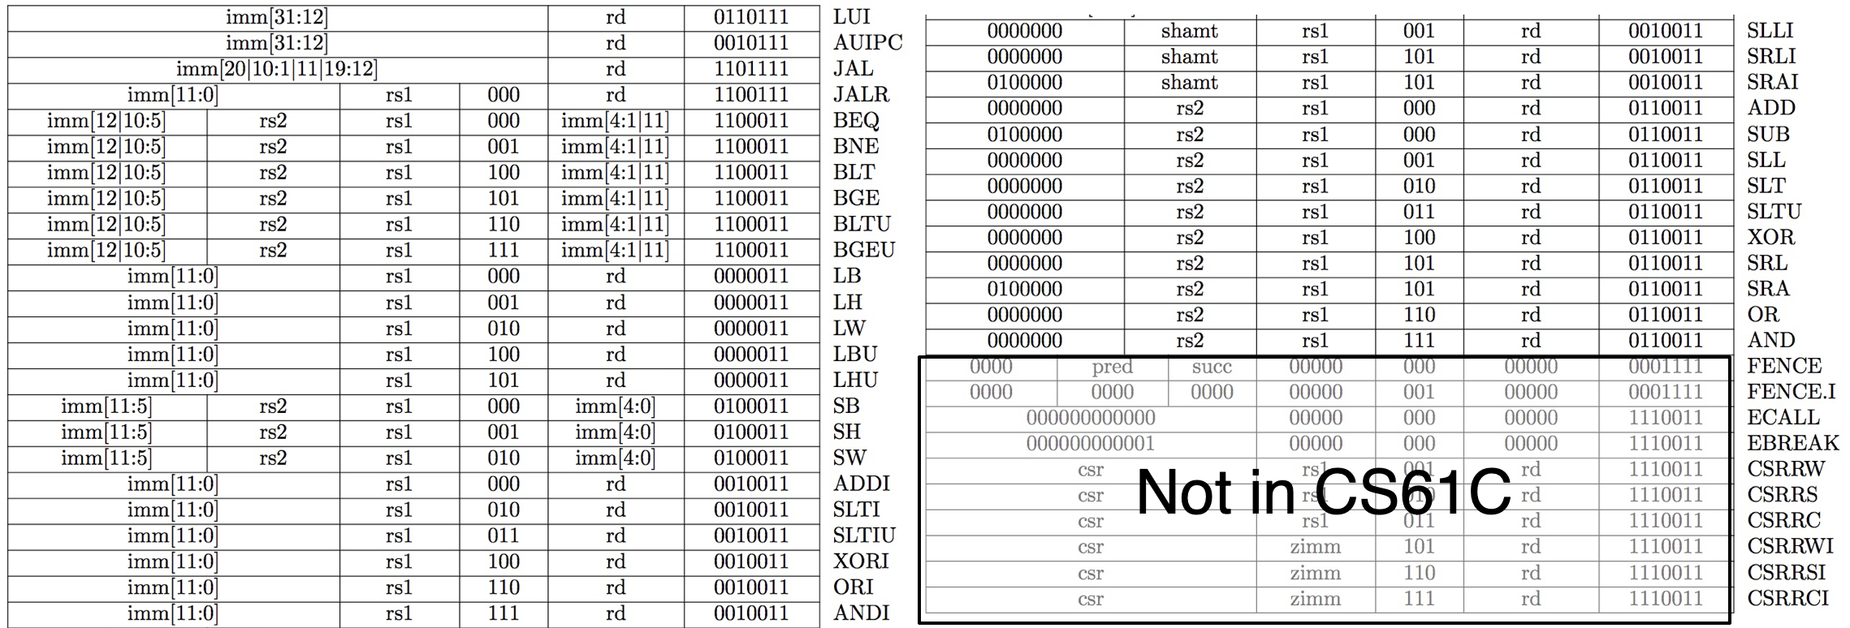
“And in Conclusion…”
We’ve covered (almost) the entire RV32 ISA!
Practice assembling and disassembling!
https://riscv.org/technical/specifications/

